Slide 1
SPACEX FALCON 9
Data Science Capstone Project Report
Predicting historical
first-stage landing outcomes
API collection | Web scraping | SQL | Visual EDA
Folium mapping | Dash dashboard | Machine learning
Original reproducible analysis with documented historical samples
https://github.com/giusdp45/spacex-landing-capstone
01
Notes:
Sources and reproducibility:
https://github.com/giusdp45/spacex-landing-capstone
All calculated results come from the submitted scripts and executed notebooks. Sample definitions and limitations are stated on the slides.

Slide 2
OVERVIEW
Executive summary
Methods: enrich API records, scrape launch tables, create landing labels, run 11 SQL queries and six EDA charts, map geography, build Dash filters, and tune four classifier families.
Results: 60 of 90 launches have Class 1 labels (66.7%). SVM leads training CV at 88.9%; held-out accuracy is 77.8% on 18 launches. All 12 successes are detected, but four class-0 cases are predicted successful.
Decision: promising historical associations require caution. A temporal test reaches 88.9% against an 83.3% majority baseline. Labels, small samples and changing launch eras limit operational use.
https://github.com/giusdp45/spacex-landing-capstone
02
Notes:
Sources and reproducibility:
https://github.com/giusdp45/spacex-landing-capstone
https://cf-courses-data.s3.us.cloud-object-storage.appdomain.cloud/IBM-DS0321EN-SkillsNetwork/datasets/dataset_part_2.csv
All calculated results come from the submitted scripts and executed notebooks. Sample definitions and limitations are stated on the slides.

Slide 3
OVERVIEW
Introduction: the business question
Reusable first stages can affect launch economics. This project studies whether historical launch characteristics help predict the observed first-stage landing label.
Question: how do launch site, orbit, payload, booster configuration and flight sequence relate to landing outcomes, and which classifier generalizes best within these data?
Scope: Falcon 9 historical records. No cost data are supplied, so landing probabilities are not converted into a claimed launch price or savings estimate.
https://github.com/giusdp45/spacex-landing-capstone
03
Notes:
Sources and reproducibility:
https://github.com/giusdp45/spacex-landing-capstone
https://www.spacex.com/vehicles/falcon-9/
All calculated results come from the submitted scripts and executed notebooks. Sample definitions and limitations are stated on the slides.

Slide 4
DATA PROVENANCE
Three samples, three distinct purposes
Sample | Rows / dates | Used for
IBM API-derived snapshot | 90 | Jun 2010-Nov 2020 | Visual EDA and prediction
Wikipedia fixed revision | 122 | Jun 2010-Jun 2021 | Scraping and SQL
IBM Dash / geographic sample | 56 | 2010-2018 | Dashboard and maps
Samples are analyzed separately. Differences in counts and outcome definitions are explained; percentages from different samples are not interchangeable.
https://github.com/giusdp45/spacex-landing-capstone
04
Notes:
Sources and reproducibility:
https://github.com/giusdp45/spacex-landing-capstone
https://cf-courses-data.s3.us.cloud-object-storage.appdomain.cloud/IBM-DS0321EN-SkillsNetwork/datasets/dataset_part_2.csv
https://en.wikipedia.org/w/index.php?title=List_of_Falcon_9_and_Falcon_Heavy_launches&oldid=1027686922
https://cf-courses-data.s3.us.cloud-object-storage.appdomain.cloud/IBM-DS0321EN-SkillsNetwork/datasets/spacex_launch_dash.csv
All calculated results come from the submitted scripts and executed notebooks. Sample definitions and limitations are stated on the slides.

Slide 5
METHODOLOGY
Data collection: SpaceX API
GET /v4/launches/past -> enrich rockets, payloads, cores and launchpads -> retain Falcon 9, one payload and one core -> restrict date -> normalize records to a pandas DataFrame.
Collected fields include date, flight number, payload mass, orbit, site, core flights, grid fins, legs, reuse, block, serial, coordinates and landing outcome.
The live endpoint returned HTTP 525. The executed notebook records this error and loads the official frozen 90-row course snapshot. Live collection is reproducible code, with a transparent fallback.
https://github.com/giusdp45/spacex-landing-capstone/blob/main/notebooks/01_API_Data_Collection.ipynb
05
Notes:
Sources and reproducibility:
https://github.com/giusdp45/spacex-landing-capstone
https://github.com/r-spacex/SpaceX-API/tree/master/docs/v4
https://cf-courses-data.s3.us.cloud-object-storage.appdomain.cloud/IBM-DS0321EN-SkillsNetwork/datasets/dataset_part_1.csv
All calculated results come from the submitted scripts and executed notebooks. Sample definitions and limitations are stated on the slides.

Slide 6
METHODOLOGY
Data collection: web scraping
Download fixed Wikipedia revision 1027686922 -> BeautifulSoup finds launch wikitables -> pandas reads cells -> remove description rows, footnotes and Falcon Heavy records.
Parse date and kilograms; preserve unknown mass as missing. Separate mission launch success from booster landing result and landing type. Remove duplicate flight numbers and sort chronologically.
Output: 122 Falcon 9 records through 2021-06-06, with five unknown payload masses. Historical site names remain visible, including Cape Canaveral naming changes.
https://github.com/giusdp45/spacex-landing-capstone/blob/main/notebooks/02_Web_Scraping.ipynb
06
Notes:
Sources and reproducibility:
https://github.com/giusdp45/spacex-landing-capstone
https://en.wikipedia.org/w/index.php?title=List_of_Falcon_9_and_Falcon_Heavy_launches&oldid=1027686922
All calculated results come from the submitted scripts and executed notebooks. Sample definitions and limitations are stated on the slides.

Slide 7
METHODOLOGY
Data wrangling: define the target carefully
Class 0: False ASDS, False Ocean, False RTLS, None ASDS and None None. All other outcomes map to Class 1. The calculated labels match the course reference: 60 ones and 30 zeros.
Validate unique flight numbers and numeric fields. For modeling, reverse the frozen payload mean-imputation sentinel; median imputation, standardization and one-hot encoding fit inside each training fold.
Outcome, landing pad, serial and eventual reuse count are omitted from predictors. Class 0 includes no attempt and unknown; Class 1 includes True Ocean, so this is not a direct booster-reuse target.
https://github.com/giusdp45/spacex-landing-capstone/blob/main/notebooks/03_Data_Wrangling.ipynb
07
Notes:
Sources and reproducibility:
https://github.com/giusdp45/spacex-landing-capstone
https://cf-courses-data.s3.us.cloud-object-storage.appdomain.cloud/IBM-DS0321EN-SkillsNetwork/datasets/dataset_part_1.csv
https://cf-courses-data.s3.us.cloud-object-storage.appdomain.cloud/IBM-DS0321EN-SkillsNetwork/datasets/dataset_part_2.csv
All calculated results come from the submitted scripts and executed notebooks. Sample definitions and limitations are stated on the slides.

Slide 8
METHODOLOGY
Visual EDA: what each chart examines
Chart | Analytical purpose
Flight number vs site | Compare launch era and outcome across sites
Payload vs site | Compare mass ranges and outcomes by site
Success rate by orbit | Identify differences, with group sample sizes
Flight number vs orbit | See changing orbit mix and experience
Payload vs orbit | Examine mission energy / mass associations
Annual success trend | Track historical changes and exceptions
Color identifies Class 0 versus Class 1. These are descriptive relationships; site and orbit choices can be confounded by mission type and era.
https://github.com/giusdp45/spacex-landing-capstone/blob/main/notebooks/05_EDA_Visualization.ipynb
08
Notes:
Sources and reproducibility:
https://github.com/giusdp45/spacex-landing-capstone
https://cf-courses-data.s3.us.cloud-object-storage.appdomain.cloud/IBM-DS0321EN-SkillsNetwork/datasets/dataset_part_2.csv
All calculated results come from the submitted scripts and executed notebooks. Sample definitions and limitations are stated on the slides.

Slide 9
METHODOLOGY
SQL EDA: turn questions into queries
Store the scraped table in SQLite. DISTINCT and LIKE identify sites and initial launches; SUM and AVG summarize NASA CRS payload and Falcon 9 v1.1 payload.
MIN(Date) identifies the first successful ground landing. WHERE filters successful drone landings with payload 4,000-6,000 kg and failed drone landings in 2015.
GROUP BY counts launch outcomes and site success rates. A MAX subquery returns all maximum-payload boosters. Date filtering and ORDER BY rank historical landing outcomes. All 11 query outputs are retained.
https://github.com/giusdp45/spacex-landing-capstone/blob/main/notebooks/04_EDA_SQL.ipynb
09
Notes:
Sources and reproducibility:
https://github.com/giusdp45/spacex-landing-capstone
https://en.wikipedia.org/w/index.php?title=List_of_Falcon_9_and_Falcon_Heavy_launches&oldid=1027686922
All calculated results come from the submitted scripts and executed notebooks. Sample definitions and limitations are stated on the slides.

Slide 10
METHODOLOGY
Interactive analytics: Folium and Dash
Folium: plot four historical site labels, cluster 56 records with green/red landing markers, add launch/date popups and measure geographic proximity using OpenStreetMap segments.
Dash: launch-site dropdown updates success pie charts; payload RangeSlider and site selection update the mass-versus-class scatter, colored by booster version.
The 56-row sample has 24 Class 1 records. Charts distinguish a site's share of all successes from its within-site success rate.
Folium code: https://github.com/giusdp45/spacex-landing-capstone/blob/main/scripts/build_maps.py
https://github.com/giusdp45/spacex-landing-capstone/blob/main/scripts/spacex_dash_app.py
10
Notes:
Sources and reproducibility:
https://github.com/giusdp45/spacex-landing-capstone
https://cf-courses-data.s3.us.cloud-object-storage.appdomain.cloud/IBM-DS0321EN-SkillsNetwork/datasets/spacex_launch_geo.csv
https://cf-courses-data.s3.us.cloud-object-storage.appdomain.cloud/IBM-DS0321EN-SkillsNetwork/datasets/spacex_launch_dash.csv
All calculated results come from the submitted scripts and executed notebooks. Sample definitions and limitations are stated on the slides.

Slide 11
VISUAL EDA
Flight number vs launch site
1 = CCAFS SLC 40 | 2 = KSC LC 39A | 3 = VAFB SLC 4E
Later flights contain more successful labels. KSC and VAFB have rates near 77%, versus 60% for CCAFS; site effects also reflect launch era and mission mix.
https://github.com/giusdp45/spacex-landing-capstone
11
Notes:
Sources and reproducibility:
https://github.com/giusdp45/spacex-landing-capstone
https://cf-courses-data.s3.us.cloud-object-storage.appdomain.cloud/IBM-DS0321EN-SkillsNetwork/datasets/dataset_part_2.csv
All calculated results come from the submitted scripts and executed notebooks. Sample definitions and limitations are stated on the slides.

Slide 12
VISUAL EDA
Payload mass vs launch site
1 = CCAFS SLC 40 | 2 = KSC LC 39A | 3 = VAFB SLC 4E
Success and class-0 outcomes overlap in payload mass. VAFB occupies a narrower mass range; payload alone does not separate landing outcomes.
https://github.com/giusdp45/spacex-landing-capstone
12
Notes:
Sources and reproducibility:
https://github.com/giusdp45/spacex-landing-capstone
https://cf-courses-data.s3.us.cloud-object-storage.appdomain.cloud/IBM-DS0321EN-SkillsNetwork/datasets/dataset_part_2.csv
All calculated results come from the submitted scripts and executed notebooks. Sample definitions and limitations are stated on the slides.

Slide 13
VISUAL EDA
Landing success rate by orbit
n: ES-L1=1 | GEO=1 | HEO=1 | SSO=5 | VLEO=14 | LEO=7 | PO=9 | MEO=3 | ISS=21 | GTO=27 | SO=1
GTO: 51.9% (27 launches); ISS: 61.9% (21); VLEO: 85.7% (14). Several 100% rates come from only one launch, so they provide little evidence.
https://github.com/giusdp45/spacex-landing-capstone
13
Notes:
Sources and reproducibility:
https://github.com/giusdp45/spacex-landing-capstone
https://cf-courses-data.s3.us.cloud-object-storage.appdomain.cloud/IBM-DS0321EN-SkillsNetwork/datasets/dataset_part_2.csv
All calculated results come from the submitted scripts and executed notebooks. Sample definitions and limitations are stated on the slides.

Slide 14
VISUAL EDA
Flight number vs orbit
1 = ES-L1 | 2 = GEO | 3 = HEO | 4 = SSO | 5 = VLEO | 6 = LEO | 7 = PO | 8 = MEO | 9 = ISS | 10 = GTO | 11 = SO
Orbit mix changes over time. VLEO launches occur later and mostly succeed; temporal experience and mission selection should be considered together.
https://github.com/giusdp45/spacex-landing-capstone
14
Notes:
Sources and reproducibility:
https://github.com/giusdp45/spacex-landing-capstone
https://cf-courses-data.s3.us.cloud-object-storage.appdomain.cloud/IBM-DS0321EN-SkillsNetwork/datasets/dataset_part_2.csv
All calculated results come from the submitted scripts and executed notebooks. Sample definitions and limitations are stated on the slides.

Slide 15
VISUAL EDA
Payload mass vs orbit
1 = ES-L1 | 2 = GEO | 3 = HEO | 4 = SSO | 5 = VLEO | 6 = LEO | 7 = PO | 8 = MEO | 9 = ISS | 10 = GTO | 11 = SO
Large VLEO payloads can coincide with successful landings. GTO outcomes are mixed. Orbital mission requirements matter alongside mass; the plot cannot establish a causal threshold.
https://github.com/giusdp45/spacex-landing-capstone
15
Notes:
Sources and reproducibility:
https://github.com/giusdp45/spacex-landing-capstone
https://cf-courses-data.s3.us.cloud-object-storage.appdomain.cloud/IBM-DS0321EN-SkillsNetwork/datasets/dataset_part_2.csv
All calculated results come from the submitted scripts and executed notebooks. Sample definitions and limitations are stated on the slides.

Slide 16
VISUAL EDA
Success changes across launch years
Success reaches 90.0% in 2019 and 84.2% in 2020, with a dip to 61.1% in 2018. No 2011 record appears in this filtered sample; early years have very small counts.
https://github.com/giusdp45/spacex-landing-capstone
16
Notes:
Sources and reproducibility:
https://github.com/giusdp45/spacex-landing-capstone
https://cf-courses-data.s3.us.cloud-object-storage.appdomain.cloud/IBM-DS0321EN-SkillsNetwork/datasets/dataset_part_2.csv
All calculated results come from the submitted scripts and executed notebooks. Sample definitions and limitations are stated on the slides.

Slide 17
SQL RESULTS
SQL results: sites and the first five CCAFS launches
Six site strings: CCAFS SLC 40; CCSFS SLC 40; Cape Canaveral LC 40; Cape Canaveral SLC 40; KSC LC 39A; VAFB SLC 4E.
Date | Flight | Site
2010-06-04 | 1 | CCAFS SLC 40
2010-12-08 | 2 | CCAFS SLC 40
2012-05-22 | 3 | CCAFS SLC 40
2012-10-08 | 4 | CCAFS SLC 40
2013-03-01 | 5 | CCAFS SLC 40
Historical Cape Canaveral names refer to naming changes around LC/SLC 40; six strings should not be interpreted as six independent physical launch sites.
https://github.com/giusdp45/spacex-landing-capstone
17
Notes:
Sources and reproducibility:
https://github.com/giusdp45/spacex-landing-capstone
https://en.wikipedia.org/w/index.php?title=List_of_Falcon_9_and_Falcon_Heavy_launches&oldid=1027686922
All calculated results come from the submitted scripts and executed notebooks. Sample definitions and limitations are stated on the slides.

Slide 18
SQL RESULTS
SQL results: payload and mission launch success
Query | Result | Sample detail
NASA CRS total payload | 59,941 kg | 22 launches; all 22 masses known
Falcon 9 v1.1 average payload | 2,534.7 kg | 15 launches; all 15 masses known
Mission launch outcome | 120 success / 2 other | 122 scraped launches; 98.4% success
First successful ground landing | 2015-12-22 | MIN(Date) where ground landing succeeds
Mission launch success differs from booster landing success. Unknown masses stay NULL in SQL; these aggregates are sums and means of reported masses.
https://github.com/giusdp45/spacex-landing-capstone
18
Notes:
Sources and reproducibility:
https://github.com/giusdp45/spacex-landing-capstone
https://en.wikipedia.org/w/index.php?title=List_of_Falcon_9_and_Falcon_Heavy_launches&oldid=1027686922
All calculated results come from the submitted scripts and executed notebooks. Sample definitions and limitations are stated on the slides.

Slide 19
SQL RESULTS
SQL results: drone landings with 4,000-6,000 kg
Date | Booster | Payload kg
2016-05-06 | F9 FT B1022.1 | 4696
2016-08-14 | F9 FT B1026.1 | 4600
2017-03-30 | F9 FT B1021.2 | 5300
2017-10-11 | F9 FT B1031.2 | 5200
2018-08-07 | F9 B5 B1046.2 | 5800
2018-11-15 | F9 B5 B1047.2 | 5300
2019-02-22 | F9 B5 B1048.3 | 4850
2020-06-30 | F9 B5 B1060.1 | 4311
2020-11-05 | F9 B5 B1062.1 | 4311
2021-01-24 | F9 B5 B1058.5 | 5000
Ten successful drone-ship landings satisfy the strict payload bounds (>4,000 and <6,000 kg) in the scraped sample.
https://github.com/giusdp45/spacex-landing-capstone
19
Notes:
Sources and reproducibility:
https://github.com/giusdp45/spacex-landing-capstone
https://en.wikipedia.org/w/index.php?title=List_of_Falcon_9_and_Falcon_Heavy_launches&oldid=1027686922
All calculated results come from the submitted scripts and executed notebooks. Sample definitions and limitations are stated on the slides.

Slide 20
SQL RESULTS
SQL results: maximum payload boosters (1/3)
Date | Booster version | Payload kg
2019-11-11 | F9 B5 B1048.4 | 15600
2020-01-07 | F9 B5 B1049.4 | 15600
2020-01-29 | F9 B5 B1051.3 | 15600
2020-02-17 | F9 B5 B1056.4 | 15600
2020-03-18 | F9 B5 B1048.5 | 15600
2020-04-22 | F9 B5 B1051.4 | 15600
2020-06-04 | F9 B5 B1049.5 | 15600
2020-09-03 | F9 B5 B1060.2 | 15600
All 24 records tie at the maximum reported payload of 15,600 kg. The query returns every tie; unknown masses are excluded by SQL MAX.
https://github.com/giusdp45/spacex-landing-capstone
20
Notes:
Sources and reproducibility:
https://github.com/giusdp45/spacex-landing-capstone
https://en.wikipedia.org/w/index.php?title=List_of_Falcon_9_and_Falcon_Heavy_launches&oldid=1027686922
All calculated results come from the submitted scripts and executed notebooks. Sample definitions and limitations are stated on the slides.

Slide 21
SQL RESULTS
SQL results: maximum payload boosters (2/3)
Date | Booster version | Payload kg
2020-10-06 | F9 B5 B1058.3 | 15600
2020-10-18 | F9 B5 B1051.6 | 15600
2020-10-24 | F9 B5 B1060.3 | 15600
2020-11-25 | F9 B5 B1049.7 | 15600
2021-01-20 | F9 B5 B1051.8 | 15600
2021-02-04 | F9 B5 B1060.5 | 15600
2021-02-16 | F9 B5 B1059.6 | 15600
2021-03-04 | F9 B5 B1049.8 | 15600
All 24 records tie at the maximum reported payload of 15,600 kg. The query returns every tie; unknown masses are excluded by SQL MAX.
https://github.com/giusdp45/spacex-landing-capstone
21
Notes:
Sources and reproducibility:
https://github.com/giusdp45/spacex-landing-capstone
https://en.wikipedia.org/w/index.php?title=List_of_Falcon_9_and_Falcon_Heavy_launches&oldid=1027686922
All calculated results come from the submitted scripts and executed notebooks. Sample definitions and limitations are stated on the slides.

Slide 22
SQL RESULTS
SQL results: maximum payload boosters (3/3)
Date | Booster version | Payload kg
2021-03-11 | F9 B5 B1058.6 | 15600
2021-03-14 | F9 B5 B1051.9 | 15600
2021-03-24 | F9 B5 B1060.6 | 15600
2021-04-07 | F9 B5 B1058.7 | 15600
2021-04-29 | F9 B5 B1060.7 | 15600
2021-05-04 | F9 B5 B1049.9 | 15600
2021-05-09 | F9 B5 B1051.10 | 15600
2021-05-26 | F9 B5 B1063.2 | 15600
All 24 records tie at the maximum reported payload of 15,600 kg. The query returns every tie; unknown masses are excluded by SQL MAX.
https://github.com/giusdp45/spacex-landing-capstone
22
Notes:
Sources and reproducibility:
https://github.com/giusdp45/spacex-landing-capstone
https://en.wikipedia.org/w/index.php?title=List_of_Falcon_9_and_Falcon_Heavy_launches&oldid=1027686922
All calculated results come from the submitted scripts and executed notebooks. Sample definitions and limitations are stated on the slides.

Slide 23
SQL RESULTS
SQL results: 2015 failures and landing rankings
2015 month | Booster | Site / landing result
January | F9 v1.1 B1012 | Cape Canaveral LC 40 | failed drone landing
April | F9 v1.1 B1015 | Cape Canaveral LC 40 | failed drone landing
Landing result | Landing type | Count (2010-06-04 to 2017-03-20)
No attempt | Other / no attempt | 10
Failure | Drone ship | 5
Other | Ocean | 5
Success | Drone ship | 5
Success | Ground pad | 3
Failure | Other / no attempt | 2
Other | Drone ship | 2
https://github.com/giusdp45/spacex-landing-capstone
23
Notes:
Sources and reproducibility:
https://github.com/giusdp45/spacex-landing-capstone
https://en.wikipedia.org/w/index.php?title=List_of_Falcon_9_and_Falcon_Heavy_launches&oldid=1027686922
All calculated results come from the submitted scripts and executed notebooks. Sample definitions and limitations are stated on the slides.

Slide 24
SQL RESULTS
SQL results: landing rates by historical site name
Site string | Launches | Successful landings | Success rate
Cape Canaveral SLC 40 | 1 | 1 | 100%
CCSFS SLC 40 | 12 | 11 | 91.7%
KSC LC 39A | 33 | 28 | 84.8%
VAFB SLC 4E | 16 | 10 | 62.5%
CCAFS SLC 40 | 40 | 24 | 60%
Cape Canaveral LC 40 | 20 | 6 | 30%
Cape Canaveral aliases and sample sizes affect these rankings. The 100% group contains one launch; normalize aliases and control for era before drawing a site-performance conclusion.
https://github.com/giusdp45/spacex-landing-capstone
24
Notes:
Sources and reproducibility:
https://github.com/giusdp45/spacex-landing-capstone
https://en.wikipedia.org/w/index.php?title=List_of_Falcon_9_and_Falcon_Heavy_launches&oldid=1027686922
All calculated results come from the submitted scripts and executed notebooks. Sample definitions and limitations are stated on the slides.

Slide 25
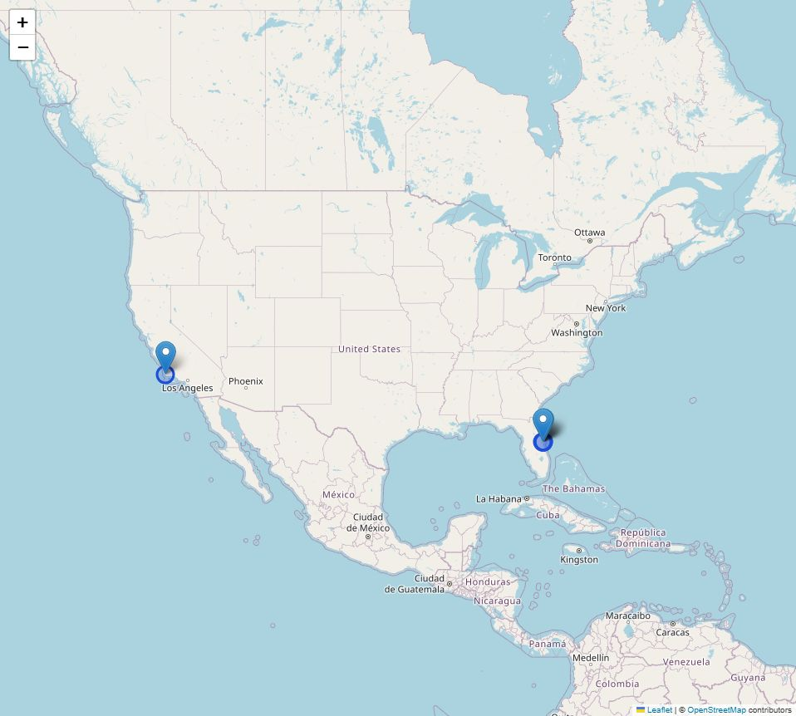
INTERACTIVE ANALYTICS
Folium results: launch-site markers
Four historical site labels map to the Florida and California coasts. Nearby Florida markers overlap at national scale.
Markers provide site names and coordinates. Coastal geography is consistent with ocean-oriented launch corridors, but this map does not model safety constraints.
Interactive output: maps/launch_sites.html
https://github.com/giusdp45/spacex-landing-capstone
25
Notes:
Sources and reproducibility:
https://github.com/giusdp45/spacex-landing-capstone
OpenStreetMap contributors: https://www.openstreetmap.org/copyright
https://github.com/giusdp45/spacex-landing-capstone/blob/main/scripts/build_maps.py
All calculated results come from the submitted scripts and executed notebooks. Sample definitions and limitations are stated on the slides.

Slide 26
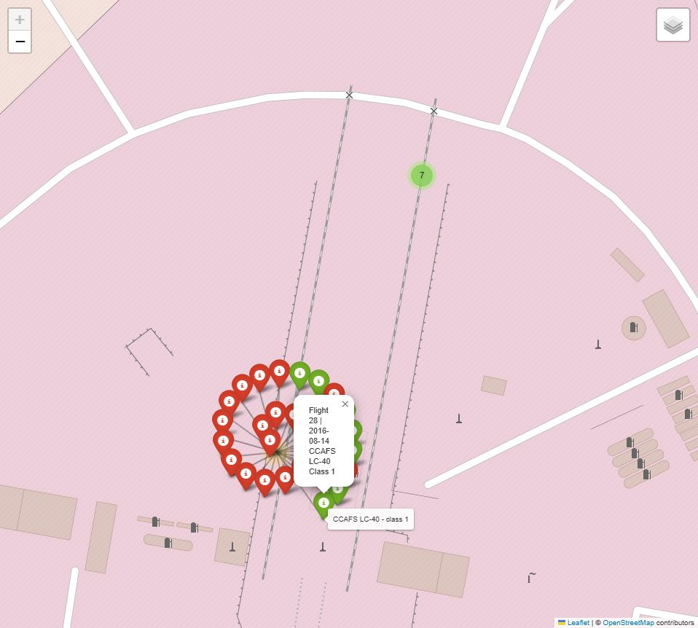
INTERACTIVE ANALYTICS
Folium results: explore landing records
MarkerCluster holds 56 launch records. Green marks Class 1; red marks Class 0.
Expanding a cluster separates coincident records. A popup shows flight number, date, site and outcome, enabling launch-by-launch exploration.
Interactive output: maps/launch_records.html
https://github.com/giusdp45/spacex-landing-capstone
26
Notes:
Sources and reproducibility:
https://github.com/giusdp45/spacex-landing-capstone
OpenStreetMap contributors: https://www.openstreetmap.org/copyright
https://github.com/giusdp45/spacex-landing-capstone/blob/main/scripts/build_maps.py
All calculated results come from the submitted scripts and executed notebooks. Sample definitions and limitations are stated on the slides.

Slide 27
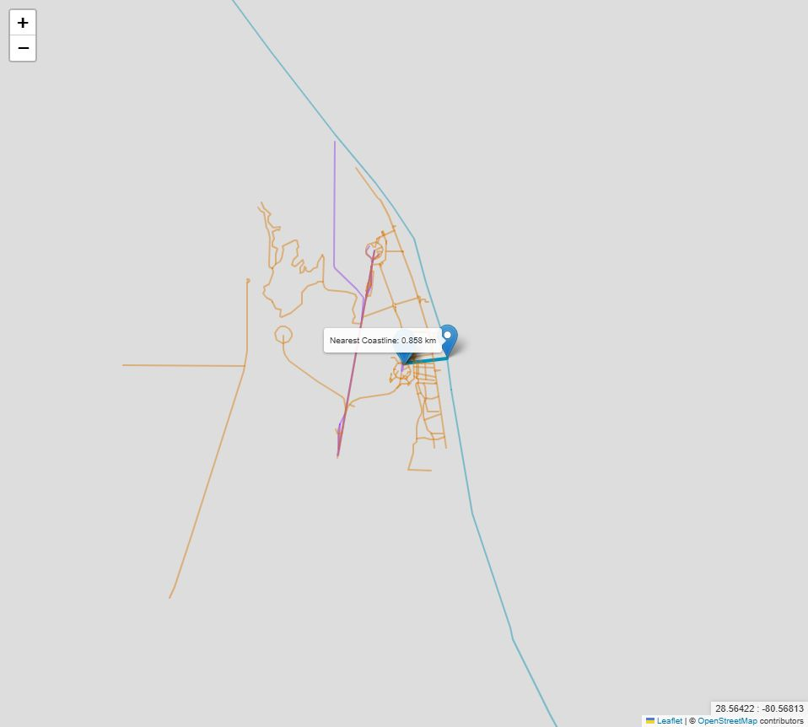
INTERACTIVE ANALYTICS
Folium results: measured site proximity
CCAFS SLC-40 to mapped coastline: 0.858 km. To nearest rail: about 0.1 m; road: about 23 m.
Distances project onto OSM segments within the documented bounding box, then use WGS84 geodesics. They are approximate and depend on map geometry.
Onsite transporter rails and service roads count. These distances do not establish access to public rail or major highways.
https://github.com/giusdp45/spacex-landing-capstone
27
Notes:
Sources and reproducibility:
https://github.com/giusdp45/spacex-landing-capstone
OpenStreetMap contributors: https://www.openstreetmap.org/copyright
https://github.com/giusdp45/spacex-landing-capstone/blob/main/scripts/build_maps.py
All calculated results come from the submitted scripts and executed notebooks. Sample definitions and limitations are stated on the slides.

Slide 28
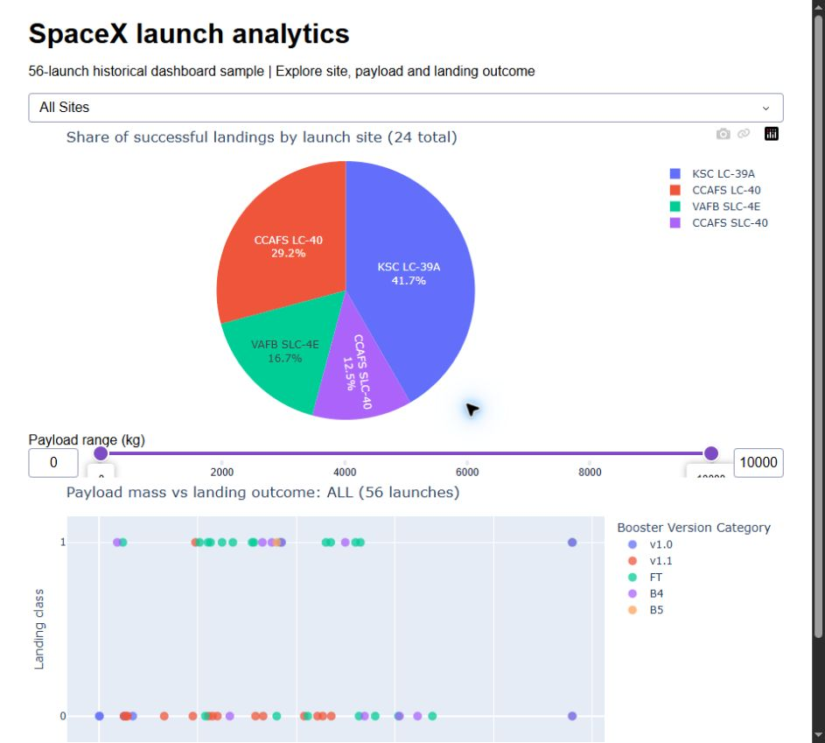
DASH DASHBOARD
Dash results: each site's share of successes
Across the 56-launch sample, 24 launches have Class 1 labels. KSC contributes 10/24 successes (41.7%), the largest share.
CCAFS LC-40: 7/24 (29.2%); VAFB: 4/24 (16.7%); CCAFS SLC-40: 3/24 (12.5%).
Share of successes is different from success rate: the denominator here is all 24 successes, not all launches at a site.
https://github.com/giusdp45/spacex-landing-capstone
28
Notes:
Sources and reproducibility:
https://github.com/giusdp45/spacex-landing-capstone
OpenStreetMap contributors: https://www.openstreetmap.org/copyright
https://github.com/giusdp45/spacex-landing-capstone/blob/main/scripts/build_maps.py
All calculated results come from the submitted scripts and executed notebooks. Sample definitions and limitations are stated on the slides.

Slide 29
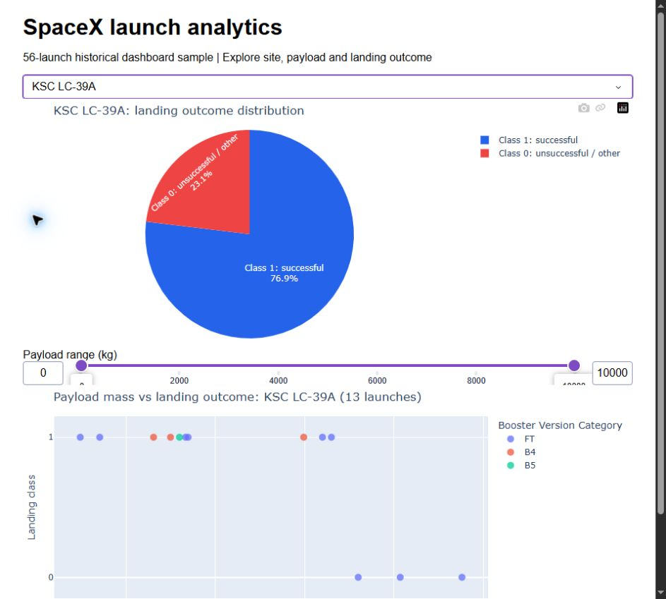
DASH DASHBOARD
Dash results: selected-site success rate
Selecting KSC LC-39A updates the pie to within-site outcomes: 10 successes from 13 launches (76.9%).
The other 3 launches have Class 0 labels (23.1%). The payload scatter simultaneously filters to KSC records.
Interactive controls support comparing sites. The rate still reflects historical mission mix and launch era.
https://github.com/giusdp45/spacex-landing-capstone
29
Notes:
Sources and reproducibility:
https://github.com/giusdp45/spacex-landing-capstone
OpenStreetMap contributors: https://www.openstreetmap.org/copyright
https://github.com/giusdp45/spacex-landing-capstone/blob/main/scripts/build_maps.py
All calculated results come from the submitted scripts and executed notebooks. Sample definitions and limitations are stated on the slides.

Slide 30
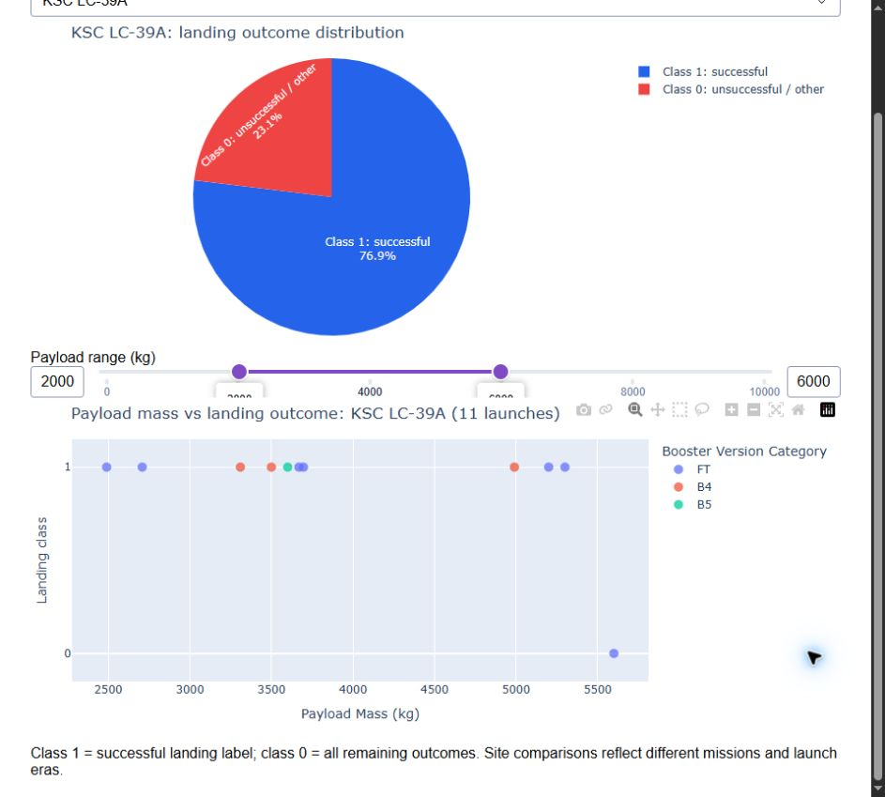
DASH DASHBOARD
Dash results: filter payload and outcome
At KSC, setting payload to 2,000-6,000 kg shows 11 launches. The scatter displays payload mass versus landing Class 0/1.
Booster-version colors expose changes in configuration. Hover details include site and flight number.
RangeSlider and dropdown callbacks are implemented in scripts/spacex_dash_app.py. Success and class-0 masses overlap.
https://github.com/giusdp45/spacex-landing-capstone
30
Notes:
Sources and reproducibility:
https://github.com/giusdp45/spacex-landing-capstone
OpenStreetMap contributors: https://www.openstreetmap.org/copyright
https://github.com/giusdp45/spacex-landing-capstone/blob/main/scripts/build_maps.py
All calculated results come from the submitted scripts and executed notebooks. Sample definitions and limitations are stated on the slides.

Slide 31
MACHINE LEARNING
Predictive analysis: preprocessing and evaluation
Predictors: FlightNumber, PayloadMass, Flights, Block, Orbit, LaunchSite, GridFins, Reused and Legs. Numeric fields use fold-level median imputation and scaling; categories use imputation and one-hot encoding.
Stratified random split: 72 training and 18 test launches (12 positives, 6 negatives). GridSearchCV tunes Logistic Regression, SVM, Decision Tree and KNN with five training folds; choose the family with highest CV accuracy.
Report held-out accuracy, balanced accuracy, precision, recall, F1 and confusion matrix. Independently test a chronological split with TimeSeriesSplit to examine temporal shift and the era proxy.
https://github.com/giusdp45/spacex-landing-capstone/blob/main/notebooks/07_Predictive_Analysis.ipynb
31
Notes:
Sources and reproducibility:
https://github.com/giusdp45/spacex-landing-capstone
https://cf-courses-data.s3.us.cloud-object-storage.appdomain.cloud/IBM-DS0321EN-SkillsNetwork/datasets/dataset_part_2.csv
All calculated results come from the submitted scripts and executed notebooks. Sample definitions and limitations are stated on the slides.

Slide 32
MACHINE LEARNING
Four classifiers: cross-validation and held-out test
SVM leads training CV at 88.9% (fold SD 6.9 points), so it is the selected model. Decision Tree has the highest random-split test accuracy (83.3%), but test data are not used to choose the winner.
https://github.com/giusdp45/spacex-landing-capstone
32
Notes:
Sources and reproducibility:
https://github.com/giusdp45/spacex-landing-capstone
https://github.com/giusdp45/spacex-landing-capstone/blob/main/scripts/analyze.py
All calculated results come from the submitted scripts and executed notebooks. Sample definitions and limitations are stated on the slides.

Slide 33
MACHINE LEARNING
Selected SVM: confusion matrix and limitations
Actual / predicted | Predicted Class 0 | Predicted Class 1
Actual Class 0 | 2 true negatives | 4 false positives
Actual Class 1 | 0 false negatives | 12 true positives
Accuracy: 77.8%
Balanced accuracy: 66.7%
Precision: 75.0%
Recall: 100.0%
F1: 85.7%
RBF SVM (C=1, gamma=scale) detects all 12 successes, but predicts success for four of six class-0 launches. It beats the 66.7% majority baseline in accuracy, with weak negative-class recall.
With 18 test launches, one changed prediction moves accuracy by 5.6 percentage points. More validation data are needed.
https://github.com/giusdp45/spacex-landing-capstone
33
Notes:
Sources and reproducibility:
https://github.com/giusdp45/spacex-landing-capstone
https://github.com/giusdp45/spacex-landing-capstone/blob/main/notebooks/07_Predictive_Analysis.ipynb
All calculated results come from the submitted scripts and executed notebooks. Sample definitions and limitations are stated on the slides.

Slide 34
MODEL VALIDATION
Additional insight: test forward in time
Temporal evaluation | Result
Training | First 72 launches; 3-fold TimeSeriesSplit
Held-out data | Last 18 launches; from 2020-01-19
Selected family / training CV | Decision Tree / 77.8%
Temporal held-out accuracy | 88.9% (16 of 18)
Always-predict-success baseline | 83.3% (15 of 18)
The temporal model gains one correct prediction over its baseline. Later launches are more often successful; high accuracy can partly reflect this shift. This supports forward validation before deployment.
https://github.com/giusdp45/spacex-landing-capstone
34
Notes:
Sources and reproducibility:
https://github.com/giusdp45/spacex-landing-capstone
https://github.com/giusdp45/spacex-landing-capstone/blob/main/scripts/analyze.py
All calculated results come from the submitted scripts and executed notebooks. Sample definitions and limitations are stated on the slides.

Slide 35
CONCLUSION
Conclusions and a practical next step
Historical landing outcomes improve with launch era, while site, orbit and payload show useful descriptive associations. These patterns are not isolated causal effects.
SVM is best by random-split training CV. Its false-positive pattern limits confident success predictions. Temporal results add useful context but only a small improvement over the majority baseline.
Next: collect recent launches, separate attempted landings from no attempt, use a recovery-for-reuse target, normalize site aliases, validate on future periods and calibrate probabilities before using them in cost scenarios.
https://github.com/giusdp45/spacex-landing-capstone
35
Notes:
Sources and reproducibility:
https://github.com/giusdp45/spacex-landing-capstone
https://cf-courses-data.s3.us.cloud-object-storage.appdomain.cloud/IBM-DS0321EN-SkillsNetwork/datasets/dataset_part_2.csv
https://en.wikipedia.org/w/index.php?title=List_of_Falcon_9_and_Falcon_Heavy_launches&oldid=1027686922
All calculated results come from the submitted scripts and executed notebooks. Sample definitions and limitations are stated on the slides.

Slide 36
PROJECT INDEX
Reproducibility: project files and sources
GitHub project: https://github.com/giusdp45/spacex-landing-capstone
notebooks/: seven executed notebooks. scripts/: API, scraping, SQL, EDA, maps and dashboard code.
data/: official course snapshots, scraped table, SQLite database, SQL result CSVs, model metrics and source manifest. maps/: interactive HTML. figures/: plots and real browser screenshots.
Sources: IBM DS0321 course datasets; SpaceX API v4 documentation; Wikipedia fixed revision 1027686922; OpenStreetMap contributors (ODbL). Source URLs are documented in README and slide notes.
https://github.com/giusdp45/spacex-landing-capstone
36
Notes:
Sources and reproducibility:
https://github.com/giusdp45/spacex-landing-capstone
https://cf-courses-data.s3.us.cloud-object-storage.appdomain.cloud/IBM-DS0321EN-SkillsNetwork/datasets/dataset_part_1.csv
https://cf-courses-data.s3.us.cloud-object-storage.appdomain.cloud/IBM-DS0321EN-SkillsNetwork/datasets/dataset_part_2.csv
https://en.wikipedia.org/w/index.php?title=List_of_Falcon_9_and_Falcon_Heavy_launches&oldid=1027686922
https://www.openstreetmap.org/copyright
All calculated results come from the submitted scripts and executed notebooks. Sample definitions and limitations are stated on the slides.

